Slide 1
COMP 2008
Course intro: Modeling and Simulation

Slide 2
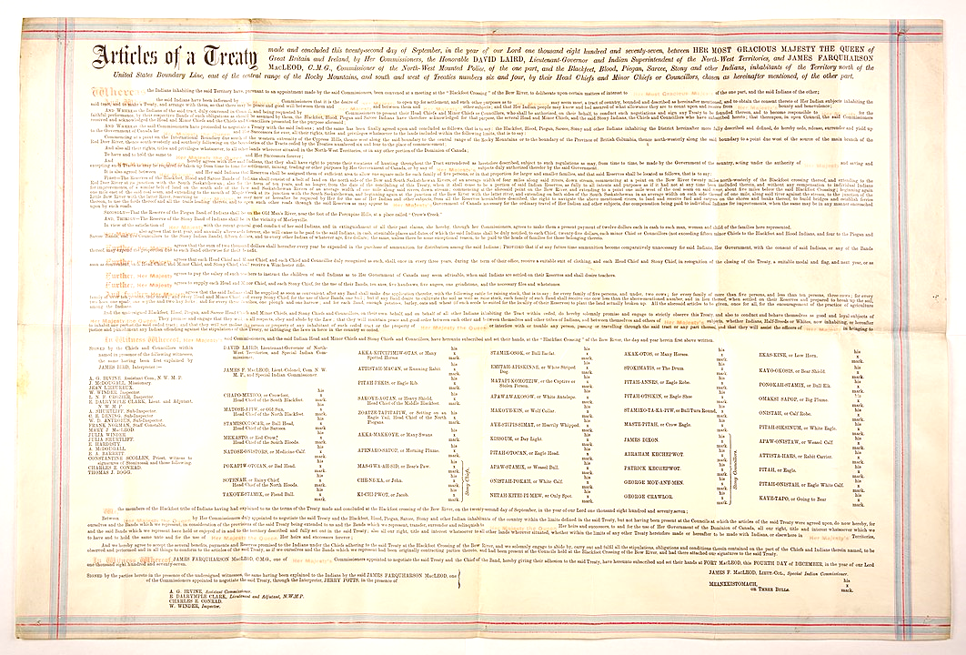
Mount Royal University is located within the traditional territories of the Niitsitapi (Blackfoot) and the people of the Treaty 7 region in Southern Alberta, which includes the Siksika, the Piikani, the Kainai, the Tsuu t’ina, and the Iyarhe Nakoda. We are situated on land where the Bow River meets the Elbow River, and the traditional Blackfoot name of this place is “Mohkinstsis,” which we now call the City of Calgary. The City of Calgary is also home to the Métis Nation.
Territory Acknowledgement
By Unknown author - University of Alberta Library Internet Archive collection - https://archive.org/details/treatyno700unse/mode/2up, Public Domain, https://commons.wikimedia.org/w/index.php?curid=89112669

Slide 3
Description & Overview
This course introduces students to the fundamentals of scientific computing, the modeling process, computer simulations, and scientific applications. While the focus is on cellular automaton simulations and Monte Carlo techniques, a limited number of system dynamics models may also be examined.
3 credit General Science option.
Prerequisite is COMP 2001 with a minimum grade of C-.
The course builds on the programming techniques introduced in COMP 2001 and applies them to scientific contexts and computational science: broadly defined as the application of computers to problems in scientific disciplines.
A selection of computer modeling and simulation techniques will be illustrated through applications to various science context.
Success in the course will require significant effort outside of class time, for studying and independent development of assessments.

Slide 4
Modality
In-person and synchronous (live) for 3 hours of lecture and 1 hour of tutorial. See your official MRU schedule for exact times, dates and locations.
If required to move online, lectures and labs will remain synchronously delivered – including the quizzes and tests, at the same times, but made available via a Google Meet.
Course email communications will be sent ONLY to your MRU Gmail account. General information, this course outline, the topic schedule, the assessment schedule, supporting resources, readings, lecture slides, assignments etc. will be made available via MRU’s learning management system.
 | M | T | W | R
2:30 | Lab 401 E203 | Lect E177 |  | Lect E177
3:00
3:30 | Lab 402 E203
4:00
4:30

Slide 5

Learning Objectives & Outcomes
Demo understanding of
Scientific computing
Models (in science and in computing)
Simulations
Apply your understanding, the scientific method and computing techniques to
Build models
Run simulations
Interpret the produced data
Draw conclusions

Slide 6

Assessments
Programming assignments
2 x 15% = 30%
Asynchronous, open, individual/paired model/simulation design and development in Python, done ‘at home’
Exercises
10%
Approximately 7 small, synchronous, small-group, open, in-person assessments, done in tutorials.
Tests
3 x 10% = 30%
In-person, individual, ‘closed’, timed, assessments (short answer, multiple choice, program or algorithm design etc.) held during scheduled class time.
Final exam
30%
Similar to tests but cumulative and scheduled by the Registrar.

Slide 7

Grading scheme
All marks are rounded to the nearest whole percent.
Percentages, letter grades and GPA marks will follow MRU’s common grading scheme available in the MRU Academic calendar.
Note the qualitative descriptors and their associated percentage:
< 50% → Fail - Does not meet the academic requirements of the course, or who cease to continue in the course, but do not withdraw as per MRU policy
< 60% → Marginal performance
< 70% → Satisfactory - Basic understanding
< 80% → Good - Clearly above-average performance, generally complete understanding..
>=80% → Excellent - Superior performance & comprehensive understanding

Slide 8
Resource requirements
Textbooks – None Required
Technologies
Recommended:
P. Deitel & H. M. Deitel, Intro to Python for Computer Science and Data Science, 2020, Pearson
C. R. Severance, Python for Everybody: Exploring Data Using Python 3, [Online.] Available: https://www.py4e.com/html3/
P. Wentworth, J. Elkner, A. B. Downey & C. Meyers, Learning with Python 3, 2012. [Online.] Available: https://openbookproject.net/thinkcs/python/english3e/
Hardware & Internet
Computer over which you have administrative control
2+ GHz
Broadband connection
Phone, tablet, netbooks are NOT sufficient
Software & Services
Current version of browser
Jupyter labs (Python’s 64-bit installation https://www.anaconda.com/products/individual#Downloads
MRU Google account
Eamil, Drive, LMS

Slide 9
Third-party app Notification
Students will be asked to use third-party vendor software applications: either downloaded to a student’s computer or installed browser extensions.
You are advised that by using them you are consenting to the potential disclosure of your personal information to external vendors which fall outside the custody and control of Mount Royal University. Limited identifiable personal information should be entered into these applications to protect your personal privacy.
Students have the right to opt out of using these third-party apps and may choose another form of academic participation subject to the agreement of the instructor. Students must notify their instructor of their intention to opt- out by the end of the first month of classes.

Slide 10
Course policies
Attendance & etiquette
Late submission of assignments
10% per day
Exercises NOT accepted late.
Missed ‘tests’
With advance notice and at the instructor’s discretion, MAY be accommodated.
Academic integrity
When in doubt, drive the mouse yourself.
Office of Student Community Standards.
Academic accommodations
Access and Inclusion Services office: Y201, (403) 440-6868 and accessibility@mtroyal.ca

Slide 11

COVID
If due to AB public health or MRU policy, we go to ‘online’ delivery:
Lectures and labs will be synchronous Google Meets (details communicated via LMS)
Recorded, posted and available until 10 days after term ends.
Tests, exam and exercises are still ‘live’ and individual but will be reworked to be ‘open’

Slide 12
Supports
Student Learning Services
403.440.6452, sls@mtroyal.ca
Early Support program
MRU IT Service desk
Department Lab Assistants
Steve Kalmar & Jordan Pratt
Offices behind B107 lab.

Slide 13
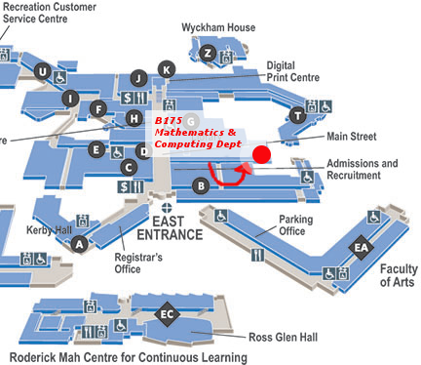
Me
Room: B175-F
pperri@mtroyal.ca
MRU Google calendar for drop-in and bookable office hours

Slide 14
Questions?

